Slide 1
Java DataBase Connectivity ( JDBC )

Slide 2

Objective
At the end of the session, participants will be able to:
Understand JDBC Architecture
Perform CRUD operations using JDBC
Execute different queries form front end to backend
Manage Transaction using JDBC
Copyright © 2016 Tech Mahindra. All Rights Reserved.

Slide 3

Agenda
JDBC Architecture
Loading JDBC Driver
Connecting to Database
Manipulate data in the Database
Transaction Management
CONFIDENTIAL© Copyright 2008 Tech Mahindra Limited
Copyright © 2016 Tech Mahindra. All Rights Reserved.

Slide 4
What is JDBC?
An API specification developed by Sun Microsystems
Defines a uniform interface for accessing various relational databases
The JDBC API uses a Driver Manager and database-specific drivers to provide connectivity to heterogeneous databases
Driver Manager can support multiple concurrent drivers connected to multiple heterogeneous databases
A JDBC driver translates standard JDBC calls into a network or database protocol or into a database library API call that facilitates communication with the database
Copyright © 2016 Tech Mahindra. All Rights Reserved.

Slide 5

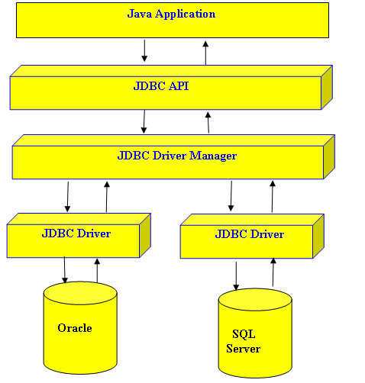
JDBC Architecture
Copyright © 2016 Tech Mahindra. All Rights Reserved.
Notes:
1) Java Developers found that they require a frame work that will allow
them to build a uniform interface over the database connectivity systems.
Such a framework would allow programmer to write a single database
interface over many Platforms.
2)This frame work is known as the java database connectivity interface.
3) JDBC is closely modeled on the SQL call level interface.
4) JDBC layer comprises of two main layers:-
a) JDBC API
b) JDBC Driver API
5)The JDBC API is the layer with which the java program interfaces
It basically defines set of classes for use in java applet /applications which are
independent of the underlying database.
6) The JDBC Driver API on the other hand ,provides link between the database and JDBC API.
7) The JDBC Driver API layer is provided by the database Vendor.
8) JDBC API is made up of 4 main interfaces:-
a) java.sql.DriverManager
b) java.sql.Connection
c) java.sql.Statement
d) java.sql.ResultSet
In addition to these, the following support interfaces are also available
java.sql.CallableStatement
java.sql.PreparedStatement
java.sql.ResultSetMetadata
java.sql.DatabaseMetaData

Slide 6
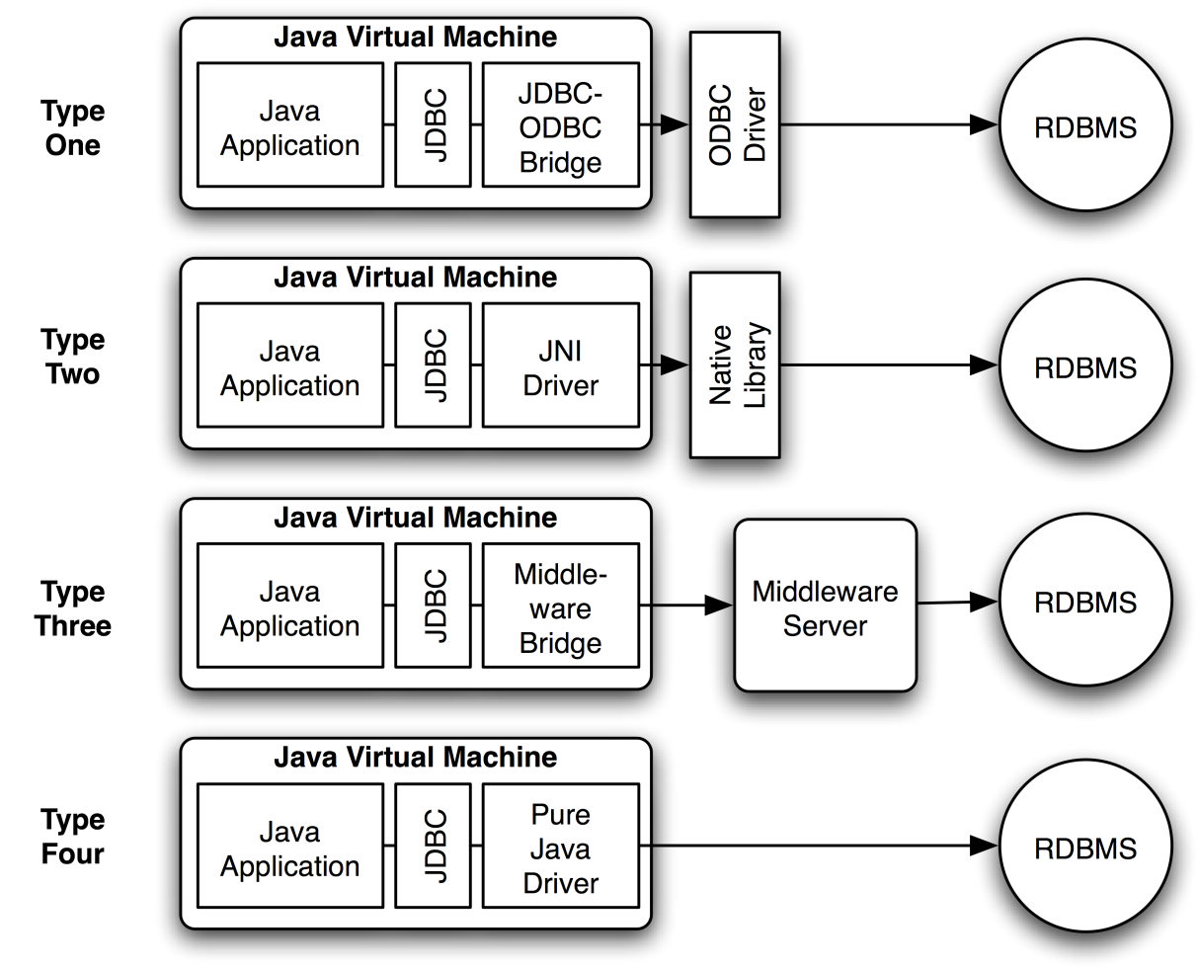
Types of JDBC Drivers
Four distinct types of JDBC drivers:
JDBC-ODBC Bridge Driver
OR Type1
Native API Java Driver
OR Type2
Java to Network Protocol
OR Driver - Type3
Pure Java Driver
OR Type4
[ Note : Type 4 driver is frequently used in applications because of its features. ]
Copyright © 2016 Tech Mahindra. All Rights Reserved.
Notes:
Type 1: JDBC-ODBC Bridge Driver
In a Type 1 driver, a JDBC bridge is used to access ODBC drivers installed on each client machine. Using ODBC, requires configuring on your system a Data Source Name (DSN) that represents the target database.
When Java first came out, this was a useful driver because most databases only supported ODBC access but now this type of driver is recommended only for experimental use or when no other alternative is available.
The JDBC-ODBC Bridge that comes with JDK 1.2 is a good example of this kind of driver.
Type 2: JDBC-Native API
In a Type 2 driver, JDBC API calls are converted into native C/C++ API calls, which are unique to the database. These drivers are typically provided by the database vendors and used in the same manner as the JDBC-ODBC Bridge. The vendor-specific driver must be installed on each client machine.
If we change the Database, we have to change the native API, as it is specific to a database and they are mostly obsolete now, but you may realize some speed increase with a Type 2 driver, because it eliminates ODBC's overhead.
The Oracle Call Interface (OCI) driver is an example of a Type 2 driver.
Type 3: JDBC-Net pure Java
In a Type 3 driver, a three-tier approach is used to access databases. The JDBC clients use standard network sockets to communicate with a middleware application server. The socket information is then translated by the middleware application server into the call format required by the DBMS, and forwarded to the database server.
This kind of driver is extremely flexible, since it requires no code installed on the client and a single driver can actually provide access to multiple databases.
You can think of the application server as a JDBC "proxy," meaning that it makes calls for the client application. As a result, you need some knowledge of the application server's configuration in order to effectively use this driver type.
Your application server might use a Type 1, 2, or 4 driver to communicate with the database, understanding the nuances will prove helpful.
Ref : http://www.tutorialspoint.com/jdbc/jdbc-driver-types.htm

Slide 7
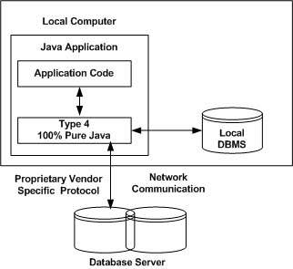
Type 4: Java to Database Protocol Driver
Copyright © 2016 Tech Mahindra. All Rights Reserved.
Notes:
Functions
Type 4 drivers are entirely written in Java that communicate directly with a vendor's
database through socket connections. No translation or middleware layers, are required,
therefore improving performance.
The driver converts JDBC calls into the vendor-specific database protocol so that client
applications can communicate directly with the database server.
Completely implemented in Java to achieve platform independence.
e.g include the widely used Oracle thin driver - oracle.jdbc.driver.
Client Machine -> Native protocol JDBC Driver -> Database server
Advantages
These drivers don't translate the requests into db request to ODBC or pass it to client API
for the db, nor do they need a middleware layer for request indirection. Thus the
performance is considerably improved.
Disadvantage
At client side, a separate driver is needed for each database.

Slide 8
Type 4: Java to Database Protocol Driver (Contd…)
Pure Java drivers that implement a proprietary database protocol to communicate directly with the database
Like Type 3 drivers, they do not require native database libraries and can be deployed over the Internet without client installation
Communicate directly with the database engine rather than through middleware or a native library
Usually the fastest JDBC drivers available
Directly converts java statements to SQL statements
Drawback :They are database / Vendor specific
Copyright © 2016 Tech Mahindra. All Rights Reserved.

Slide 9
Steps for writing JDBC code
Load and register the driver class
Establish the connection
Create a Statement
Execute the query on DB
Getting result in Java
Close the connection
Copyright © 2016 Tech Mahindra. All Rights Reserved.

Slide 10
1. Loading and registering the Driver
Can be done in two ways:
  Using DriverManager: Uses bulit in method registerDriver() to register the driver.
  Using Class.forName():
    A fully qualified name of the driver class should be passed as a parameter
    The following call will load the Type 4 driver for Oracle DB:
Class.forName (“oracle.jdbc.driver.OracleDriver”);
Copyright © 2016 Tech Mahindra. All Rights Reserved.
Notes:
Extra Notes :
Syntax for Type 1 driver JDBC-ODBC bridge:
Class.forName(“sun.jdbc.odbc.JdbcOdbcDriver”);
Please note that driver name for various databases will be different.
Eg Type 4 for MYSQL will be different than Type 4 for Oracle.

Slide 11
2. Connecting to Database
The getConnection() method is :
  A static method of DriverManager class
  Provides many overloaded versions
  Returns a Connection object
//-----------Connection with Type-4 Driver------------------//
Port
con=DriverManager.getConnection(“jdbc:oracle:thin:@10.10.3.159:1521:itpdb“,"scott","tiger");
Driver Type
Server IP
Service ID
Copyright © 2016 Tech Mahindra. All Rights Reserved.
Notes:
Syntax for connection using Type 1 driver with Oracle DB:
con=DriverManager.getConnection(“jdbc:odbc:tech”,”scott”,”tiger”);
Syntax for connection using Type 1 driver with MySql DB:
con=DriverManager.getConnection("jdbc:mysql://localhost/test?user=techm&password=techm"”);

Slide 12
Connection API Interface
When a Connection is opened, this represents a single instance of a particular database session
As long as the connection remains open, SQL queries may be executed and results obtained
Connection can be obtained from DriverManager or from DataSource( which can also return connection object from connection pool / JNDI).
Has Methods which return objects of various types of Statements.
    createStatement()
    prepareStatement()
    prepareCall()
Copyright © 2016 Tech Mahindra. All Rights Reserved.
Notes:
Note : About DataSource ,we will learn in servelts

Slide 13
3. Creating a statement using Statement API Interface
There are three types of statements. Based upon requirement any one can be used in application
Statement
PreparedStatement
CallableStatement
Copyright © 2016 Tech Mahindra. All Rights Reserved.

Slide 14
Statement API Interface
Used pass a SQL String to the database for execution and to retrieve result from database
The createStatement() method of Connection interface returns a Statement object
Connection object will give statement object
stmt=con.createStatement();
Copyright © 2016 Tech Mahindra. All Rights Reserved.

Slide 15
PreparedStatement API Interface
The prepareStatement() method of Connection interface returns a PreparedStatement object
Useful for frequently executed SQL statements and for accepting user inputs frequently at runtime.
An SQL statement is pre-compiled and gets executed more efficiently than a plain statement
For example: the statement “INSERT INTO EMP VALUES (?, ?)” can be used to add multiple records, with a different values each time
  ‘?’ acts as a placeholder
  Records are in emp table as follows:
pspmt=con.prepareStatement("insert into emp values(?,?)");
pspmt.setInt(1,26788);
pspmt.setString(2,"Ajay");
Copyright © 2016 Tech Mahindra. All Rights Reserved.

Slide 16
The PreparedStatement Interface (Contd…)
The PreparedStatement Interface:
  methods executeQuery() and executeUpdate for statement execution
  setXXX() methods for assigning values for the placeholders
    XXX stands for the data type of the value of the placeholder
    For example: setString(), setInt(), setFloat(), setDouble() etc.
To delete a record, the following code snippet is used:
Clearing parameters for executing query multiple times:
pstmt = con.prepareStatement("Delete FROM emp WHERE empno=?”)
pstmt.setString(1,eno);
int i = pstmt.executeUpdate();
pstmt.clearParameters();
Copyright © 2016 Tech Mahindra. All Rights Reserved.

Slide 17

The PreparedStatement Interface (Contd…)
To update records, the following code snippet can be used:
Best Practices : Use PreparedStatement for executing DML and SELECT queries as they are more efficient and can execute dynamic queries .
Don’t forget to clear parameters after query is executed.
PreparedStatement stmt = con.prepareStatement("update Emp SET Ename = ? WHERE Empno = ?");
stmt.setString(1,"Amit");
stmt.setString(2,“50000");
int i = stmt.executeUpdate();
stmt.clearParameters();
Copyright © 2016 Tech Mahindra. All Rights Reserved.
Notes:
void clearParameters() throws SQLException
Clears the current parameter values immediately.In general, parameter values remain in force for repeated use of a statement. Setting a parameter value automatically clears its previous value. However, in some cases it is useful to immediately release the resources used by the current parameter values; this can be done by calling the method clearParameters.

Slide 18
CallableStatement API Interface
A CallableStatement object is created by calling the prepareCall() method on a Connection object
Useful for calling and executing stored procedure (stored in backend) from Java (front end)
The object provides a way to call stored procedures in a standard way for all DBMS
CallableStatement inherits Statement methods, which deal with SQL statements in general, and it also inherits PreparedStatement methods, which deal with IN parameters
OUT parameters must be registered where as IN parameters need not to.
Copyright © 2016 Tech Mahindra. All Rights Reserved.
Notes:
CallableStatement :
The interface used to execute SQL stored procedures. The JDBC API provides a stored procedure SQL escape syntax that allows stored procedures to be called in a standard way for all RDBMSs. This escape syntax has one form that includes a result parameter and one that does not. If used, the result parameter must be registered as an OUT parameter. The other parameters can be used for input, output or both. Parameters are referred to sequentially, by number, with the first parameter being 1.
{?= call <procedure-name>[(<arg1>,<arg2>, ...)]}
{call <procedure-name>[(<arg1>,<arg2>, ...)]}
IN parameter values are set using the set methods inherited from PreparedStatement. The type of all OUT parameters must be registered prior to executing the stored procedure; their values are retrieved after execution via the get methods provided here.

Slide 19
CallableStatement Interface (Contd…)
Syntax for a stored procedure without parameters is:
{call procedure_name}
Syntax for procedure call with two parameters:
{call procedure_name(?, ?) }
Syntax for function call with three input parameters and one return value:
{?=call function_name(?,?,?) }
Copyright © 2016 Tech Mahindra. All Rights Reserved.

Slide 20
The CallableStatement Interface (Contd…)
// Creating CallableStatement
CallableStatement cs;
cs=con.prepareCall("{call SHOW_SUPPLIERS}");
ResultSet rs = cs.executeQuery();
// Stored Procedures with parameters
int age = 39;
String poetName = "dylan thomas";
CallableStatement proc =
con.prepareCall("{call set_age(?, ?)}");
proc.setString(1, poetName);
proc.setInt(2, age);
cs.execute();
Copyright © 2016 Tech Mahindra. All Rights Reserved.
Notes:
boolean execute(String sql) throws SQLExceptionExecutes
Returns:true if the first result is a ResultSet object; false if it is an update count or there are no results
the given SQL statement, which may return multiple results. In some (uncommon) situations, a single SQL statement may return multiple result sets and/or update counts. Normally you can ignore this unless you are (1) executing a stored procedure that you know may return multiple results or (2) you are dynamically executing an unknown SQL string.

Slide 21
Give this a Try…
Which Driver uses bridge to translate JDBC statements calls to the ODBC calls?
Which driver converts JDBC calls into the vendor-specific database protocol so that client applications can communicate directly with the database server?
Which interface do you think provides a way to call stored procedures in a standard way for all DBMS?
Which class should be used to efficiently execute SQL statement multiple times?
Copyright © 2016 Tech Mahindra. All Rights Reserved.
Notes:
Ans :
1. Type-1
2. Type-4
3. CallableStatement Interface
4. PreparedStatement

Slide 22
4.Executing the Query
Provides methods to execute SQL statements:
  executeQuery()
    Used for SQL statements such as simple SELECT, which return a single result set
  executeUpdate()
    Used for other SQL statements like INSERT, UPDATE & DELETE
  execute()
    Returns true if the first object that the query returns is a ResultSet object
    Use this method if the query could return one or more ResultSet objects. Retrieve the ResultSet objects returned from the query by repeatedly calling Statement.getResultSet().
Copyright © 2016 Tech Mahindra. All Rights Reserved.

Slide 23
5. Receiving output in java using ResultSet Interface
The result of an SQL statement execution can be:
  A ResultSet object
    The object returned by executeQuery() method
    Contains records retrieved by the SELECT statement
  An integer
    Returned in case of INSERT, UPDATE, DELETE statements
    Indicates the number of rows affected due to the statement
rs = stmt.executeQuery("select * from emp");
Copyright © 2016 Tech Mahindra. All Rights Reserved.

Slide 24
The ResultSet Interface (Contd…)
A ResultSet object represents the output table of data resulted from a SELECT query statement with following features:
The data in a ResultSet object is organized in rows & columns
Each ResultSet object maintains a cursor (pointer) to identify the current data row
The cursor of a newly created ResultSet object is positioned before the first row
Copyright © 2016 Tech Mahindra. All Rights Reserved.
Notes:
ResultSet objects support 3 types of scrollabilities: TYPE_FORWARD_ONLY (default), TYPE_SCROLL_INSENSITIVE, and TYPE_SCROLL_SENSITIVE.
ResultSet objects support 2 types of update capabilities: CONCUR_READ_ONLY (default) and CONCUR_UPDATABLE.
ResultSet objects support 3 types of fetch direction hints: FETCH_FORWARD (default), FETCH_REVERSE, and FETCH_UNKNOWN.
When you execute a SELECT statement with the executeQuery() method, it will return a ResultSet object.

Slide 25
The ResultSet Interface (Contd…)
Movement of the cursor depends on the scrollability of the ResultSet
  Non-scrollable ResultSet:
    Object type is ResultSet.TYPE_FORWARD_ONLY, the default type
    Supports only forward move
  Scrollable ResultSet:
    Object type is ResultSet.TYPE_SCROLL_INSENSITIVE (scrollable but not sensitive to changes made by others) or
    ResultSet.TYPE_SCROLL_SENSITIVE (scrollable and sensitive to changes made by others)
Copyright © 2016 Tech Mahindra. All Rights Reserved.

Slide 26
Updating ResultSet
updating DB record by using ResultSet
This will update the record without need to write update query.
//making result set updatable
Statement st=con.createStatement(ResultSet.TYPE_FORWARD_ONLY, ResultSet.CONCUR_UPDATABLE);
/* Updatable resultset does not work with 'select *....' query. You should mention column names explicitly to use updatable resultset */
ResultSet rs=st.executeQuery("select dno,dname,dloc from dept");
//point to record that you want to update
rs.next();
//updatable resultSet
rs.updateString(“dloc”,"Jaipur");
rs.updateRow();
Copyright © 2016 Tech Mahindra. All Rights Reserved.
Notes:
Useful for Java Programmer who are not comfortable with SQL syntaxes.. ☺

Slide 27
Scrollable ResutlSet
Scrolling records in descending order:
This will move the curser after last record and will print records in reversed manner.
//making result set scrollable
Statement st=con.createStatement(ResultSet.TYPE_SCROLL_INSENSITIVE, ResultSet.CONCUR_UPDATABLE); //can be sensitive or readable as well
ResultSet rs=st.executeQuery("select dno,dname,dloc from dept");
//point to record that you want to update
rs.afterLast();
while(rs.previous())
{
System.out.println("No="+rs.getInt(“dno”)+" Name="+rs.getString(“dname”)+" Loc="+rs.getString(“dloc”));
}
Copyright © 2016 Tech Mahindra. All Rights Reserved.

Slide 28
Explore & Learn ( for Participants ):
Updatable ResultSet
  insertRow()
  deleteRow()
Scrollable ResultSet
  beforeFirst()
  first()
  last()
  absolute()
  relative()
  [Note : Refer Java Docs for understanding concepts.]
Copyright © 2016 Tech Mahindra. All Rights Reserved.
Notes:
Non-scrollable ResultSet:-
next() - Moves the cursor forward one row from its current position.
Scrollable ResultSet supports a number of cursor move methods:
first() - Moves the cursor to the first row in this ResultSet object.
last() - Moves the cursor to the last row in this ResultSet object.
next() - Moves the cursor forward one row from its current position.
previous() - Moves the cursor backward one row from its current position.
absolute(+/-n) - Moves the cursor to the given row number in this ResultSet object. Negative row number counts backward from the last row.
relative(+/-n) -Moves the cursor a relative number of rows, either positive or negative. Attempting to move beyond the first/last row in the result set positions the cursor before/after the first/last row. Calling relative(0) is valid, but does not change the cursor position.

Slide 29
The ResultSet Interface (Contd…)
next() method:
  Moves the record pointer to the next record in the result set
  Returns a boolean value true / false, depending on whether there are records in the result set
getXXX() methods:
  XXX stands for data type of the value being retrieved
  Retrieve the values of individual column in the result set
  Two overloaded versions of each getXXX() method are provided:
    Accepting an integer argument indicating the column position
    Accepting a string argument indicating name of the column
  Note : The recommended approach is to use column names int getXXX() cause if you use index and the column gets interchanged in DB, the data access logic has to be changed to reflect new indexes.
Copyright © 2016 Tech Mahindra. All Rights Reserved.

Slide 30
The ResultSet Interface (Contd…)
Statement stmt = con.createStatement();
ResultSet rs = stmt.executeQuery(“SELECT empno, ename ,sal FROM emp”);
while (rs.next() )
{
//assuming there are 3 columns in the table
System.out.println( rs.getString(1));
System.out.println(rs.getString(2));
System.out.println(rs.getString(3));
}
rs.close(); //---- First ----//
stmt.close(); //---- Second ----//
con.close(); //---- Last ----//
System.out.println(” You are done”);
Don’t forget to close the Resultset, Statement & Connection
Maintain the sequence as shown
Copyright © 2016 Tech Mahindra. All Rights Reserved.

Slide 31
6. Closing the connection
Once the data access is done, the resultSet, Statement and connection should be closed in reverse order to ensure corresponding user process and memory allocated is released.
This can be done as follows:
try
{
// JDBC Code
}
catch(Exception e)
{
// Exception handling code
}
finally
{ //close method throws checked Exception – SQLException
// It must be handled here in finally block
rs.close();
stmt.close();
con.close();
}
Copyright © 2016 Tech Mahindra. All Rights Reserved.
Notes:
*** Please note that close() methods throws checked Exception -SQLException. Thus we need to write try catch in finally clause as well.

Slide 32
Closing the connection Cont..
From JDK 1.7 onwards we can have AutoClosable functionality for resources in try – catch block. This is called as try with resource facility in JDK 1.7
Only the objects that implements java.lang.AutoClosable interface can have this functionality.
try (Statement stmt = con.createStatement())
{
  ResultSet rs = stmt.executeQuery(query);
  while (rs.next())
  {
  String coffeeName = rs.getString("COF_NAME");
  int supplierID = rs.getInt("SUP_ID");
  float price = rs.getFloat("PRICE");
  int sales = rs.getInt("SALES");
  int total = rs.getInt("TOTAL");
  System.out.println(coffeeName + ", " + supplierID + ", " + price + ", " + sales + ", " + total);
}
} catch (SQLException e)
{
// Exception handling code }
Copyright © 2016 Tech Mahindra. All Rights Reserved.
Notes:
Note: A try-with-resources statement can have catch and finally blocks just like an ordinary try statement. In a try-with-resources statement, any catch or finally block is run after the resources declared have been closed.

Slide 33
Closing the connection Cont..
Best Practices : Always close connections (or any resource) after query execution (or use). Failure in closing connection will result in database server running out of connection and thus resulting in connection failure and application crash.
So always close connection in finally block or use try with resources feature (JDK 1.7 Onwards) to follow best practices.
Copyright © 2016 Tech Mahindra. All Rights Reserved.

Slide 34

Brain Teaser..
ResultSet connects to database and fetches record step by step. Till entire records are fetched, the connection is maintained or is required.
Lets consider a scenario that we are in middle of salary processing for employees and what if the connection is broken in middle of records ? Will it allow us to continue there after ? What can we do to avoid this?
Copyright © 2016 Tech Mahindra. All Rights Reserved.

Slide 35
Solution - JDBC RowSet
It is the wrapper of ResultSet. It holds tabular data like ResultSet but it is easy and flexible to use. Introduced from JDK 1.5
Advantages :
  Easy and flexible to use
  By default Scrollable and Updatable
A Rowset does not hold on to the database connection which was used to fetch the results of a query. Hence RowSet is Serializable. This makes a RowSet more usable in situations where we need to transfer query result over the wire.
RowSet is essentially a Java Bean. It has all the great advantages of any typical Java Bean component. One of the most distinguishing advantages of RowSet is the ability to emit events based on the actions on the RowSet. The common events which can be used with RowSet are Update Event, Delete Event and an Insert Event.
Copyright © 2016 Tech Mahindra. All Rights Reserved.

Slide 36
JDBC RowSet Cont..
Types of RowSet :
  Connected
  Disconnected
Categories according to implementations
  JdbcRowSet
  CachedRowSet
  WebRowSet
  FilteredRowSet
  JoinRowSet.
Copyright © 2016 Tech Mahindra. All Rights Reserved.
Notes:
try {
Class.forName("com.mysql.jdbc.Driver");
JdbcRowSet rowSet rowSet = new JdbcRowSetImpl();
rowSet.setUrl("jdbc:oracle:thin:@localhost:1521:xe");
rowSet.setUsername(“scott”);
rowSet.setPassword(“tiger”);
rowSet.setCommand("SELECT * FROM emp");
rowSet.execute();
} catch (Exception ex) {
ex.printStackTrace();
}
}

Slide 37
RowSet Implementation Eg:
package com.techm;
import java.sql.SQLException;
import javax.sql.rowset.JdbcRowSet;
import javax.sql.rowset.RowSetProvider;
public class RowSetDemo{
public static void main(String[] args) {
//Get rowSet
JdbcRowSet rowSet = null;
try {
rowSet=RowSetProvider.newFactory().createJdbcRowSet();
//loading driver
Class.forName("oracle.jdbc.driver.OracleDriver");
//configure rowset
rowSet.setUrl("jdbc:oracle:thin:@localhost:1521:xe");
rowSet.setUsername("system");
rowSet.setPassword("oracle");
//execute the query
rowSet.setCommand("select * from emp");
rowSet.execute();
while(rowSet.next())
{
System.out.println("Emp No="+rowSet.getInt("EmpNo")+" name="+rowSet.getString("EmpName"));
}
Copyright © 2016 Tech Mahindra. All Rights Reserved.
Notes:
You can even use:
RowSet rowset = new OracleJDBCRowSet();
In case of DataSource, you can get DataSource and use Rowset like ResultSet.
By default it will give you scrollable resultSet features.

Slide 38
RowSet Implementation (Cont..)
} //closing of try
catch (ClassNotFoundException e)
{
  e.printStackTrace();
  System.out.println("Error in loading Driver");
}catch (SQLException e)
{
e.printStackTrace();
System.out.println("Error in SQL execution");
}
finally
{
try {
rowSet.close();
} catch (SQLException e) {
e.printStackTrace();
System.out.println("Error in closing rowset");}
}
} //closing of main
} //closing of class
Copyright © 2016 Tech Mahindra. All Rights Reserved.

Slide 39
RowSet Vs ResultSet ,which should be used?
There is no rule to use RowSet only. It depends upon requirement and feasibility of the code.
A ResultSet is a essentially a connected view of the query result. The Database connection which was used for fetching the ResultSet will be held. This makes a ResultSet non-serializable.
RowSet keeps all the data from the query result in-memory. This is very in-efficient with queries that return huge data.
As the data from the ResultSet is preloaded into the RowSet, you cannot re query a particular column as a different datum. For example, lets say we want to query a Clob type as a String. In case of a RowSet, we need to change the returned Clob type to string inside the Java Code. When using a ResultSet, we can re query the same column using getString(...) method to retrieve the result as a String
In summary, RowSet and ResultSet can compliment each other nicely and each one has their own advantages and disadvantages. The key is to use the right API in the right use-case.
Copyright © 2016 Tech Mahindra. All Rights Reserved.

Slide 40
Brain Teaser..
There is a requirement in projects where application need to work with table / columns existing in a database. But UI access to database / database client IDE is not be available. You only have credentials and does not have any details about tables / columns to work upon.
How can we know about database table / columns from Java?
Copyright © 2016 Tech Mahindra. All Rights Reserved.

Slide 41
Solution - Metadata
Metadata is the key to unlock this problem.
JBDC gives us metadata which holds information about tables, columns in a database.
It can be obtained by using one of the following ways
JDBC Metadata
ResultSet MetaData
Database MetaData
Copyright © 2016 Tech Mahindra. All Rights Reserved.

Slide 42
The ResultSetMetaData Interface
getMetaData() of the ResultSet interface returns a ResultSetMetaData object containing details about the columns in a result set
Some of the methods of ResultSetMetaData interface are:
  getColumnName()
    Returns the name of a column by taking an integer argument indicating the position of the column within the result set
  getColumnType()
    Returns the data type of a column
  getColumnCount()
    Returns the number of columns included in the result set
Copyright © 2016 Tech Mahindra. All Rights Reserved.

Slide 43
The ResultSetMetaData Interface (Contd…)
rsmat=rs.getMetaData();
int cols=rsmat.getColumnCount();
while(rs.next())
{
for(int i=1;i<=cols;i++)
{
System.out.print(rs.getString(i));
}
}
Copyright © 2016 Tech Mahindra. All Rights Reserved.

Slide 44
The DatabaseMetaData Interface
Through the java.sql.DatabaseMetaData interface you can obtain meta data about the database you have connected to. For instance, you can see what tables are defined in the database, and what columns each table has, whether given features are supported etc.
To get the instance of the interface getMetadata() can be used.
Once the instance is obtained, we can use various methods available in interface to get the information about db. Few of the methods are:
  getDatabaseProductName()
  getDatabaseProductVersion()
  getTables(..)
  getColumns(..)
DatabaseMetaData dbMetaData = con.getMetaData();
Copyright © 2016 Tech Mahindra. All Rights Reserved.

Slide 45
The DatabaseMetaData Interface Cont..
Demo to print no of tables in DB.
DatabaseMetaData dbmd=con.getMetaData();
String table[]={"TABLE"};
ResultSet rs=dbmd.getTables(null,null,null,table);
while(rs.next()){
System.out.println(rs.getString(3));
}
Copyright © 2016 Tech Mahindra. All Rights Reserved.

Slide 46
Brain Teaser..
In web applications where multiple users access the same code / connection object at a time, how many connection objects should be created ?
Single or multiple connection objects for multiple users?
In case of single object – will it be sufficient to hold large information of all the active user at the same time?
In case of multiple – can server store all these objects in memory at the same time? Will it be easy to create these objects in memory and to close them frequently at runtime when load is high?
Copyright © 2016 Tech Mahindra. All Rights Reserved.

Slide 47
Solution - Connection Pooling
Java application creates a connection object every time to connect to a database
Problem :
  Process is resource heavy
  Only one user can use connection object at a time. Results in blockage if multiple users wish to access same connection object to connect with database.
Solution :
  Multiple connection objects with same characteristics can be created and held in a pool for use as and when required.
Copyright © 2016 Tech Mahindra. All Rights Reserved.

Slide 48
How it works ?
In software engineering, a connection pool is a cache of database connections maintained so that the connections can be reused when future requests to the database are required.
Connection pools are used to enhance the performance of executing commands on a database. Opening and maintaining a database connection for each user, especially requests made to a dynamic database-driven website application, is costly and wastes resources.
In connection pooling, after a connection is created, it is placed in the pool and it is used again so that a new connection does not have to be established. If all the connections are being used, a new connection is made and is added to the pool. Connection pooling also cuts down on the amount of time a user must wait to establish a connection to the database.
Copyright © 2016 Tech Mahindra. All Rights Reserved.

Slide 49
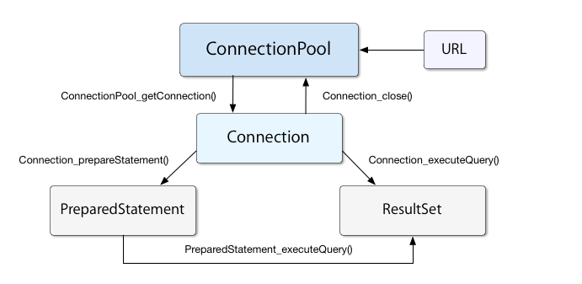
How it works ? Cont..
Copyright © 2016 Tech Mahindra. All Rights Reserved.
Notes:
Web-based and enterprise applications use an application server to handle connection pooling. Dynamic web pages without connection pooling open connections to database services as required and close them when the page is done servicing a particular request. Pages that use connection pooling, on the other hand, maintain open connections in a pool. When the page requires access to the database, it simply uses an existing connection from the pool, and establishes a new connection only if no pooled connections are available. This reduces the overhead associated with connecting to the database to service individual requests.

Slide 50
Introduction to Transaction
An indivisible unit of work comprised of several operations
Either all, or none of the units need to be performed in order to preserve data integrity
A complete task which is a combination of the smaller tasks
For a major task to be completed, smaller tasks need to be successfully completed
If any one task fails then all the previous tasks are reverted back to the original state
Copyright © 2016 Tech Mahindra. All Rights Reserved.
Notes:
For example if you are withdrawing money it consist getting money, reducing the balance from account and also printing a slip. If anything fails then all the things should be converted to its previous state. In order to achieve this type of functionality where all the queries should be completed otherwise the task should be rolled back is achieved by three methods rollback(), commit() and setAutoCommit().

Slide 51
Transaction Properties
Atomicity:
  Implies indivisibility
  Any indivisible operation (one which will either complete in totally, or not at all) is said to be atomic
Consistency:
  A transaction must transition persistent data from one consistent state to another
  In the event of a failure occurs during processing, data must be restored to the state it was in prior to the transaction
Copyright © 2016 Tech Mahindra. All Rights Reserved.
Notes:
All transactions share these properties: atomicity, consistency, isolation, and durability

Slide 52
Transaction Properties (Contd…)
Isolation:
  Transactions should not affect each other
  A transaction in progress, not yet committed or rolled back, must be isolated from other transactions
Durability:
  Once a transaction commits successfully, the state changes committed by that transaction must be durable & persistent, despite any failures that occur afterwards
CONFIDENTIAL© Copyright 2008 Tech Mahindra Limited
Copyright © 2016 Tech Mahindra. All Rights Reserved.
Notes:
All transactions share these properties: atomicity, consistency, isolation, and durability

Slide 53
Transaction Management
A connection commits all the changes once it is done with a query by default
This can be stopped by calling setAutoCommit(false) on the connection object
Now for every transaction, user will have to explicitly call the commit() method, else the changes wont be reflected in the database
The rollback() method gets called for withdrawing all the changes done by queries in the database
Copyright © 2016 Tech Mahindra. All Rights Reserved.
Notes:
1) void rollback() throws SQLException
Undoes all changes made in the current transaction and releases any database locks currently held by this Connection object. This method should be used only when auto-commit mode has been disabled.
2) void commit() throws SQLExceptionMakes all changes made since the previous commit/rollback permanent and releases any database locks currently held by this Connection object. This method should be used only when auto-commit mode has been disabled.

Slide 54
Transaction Management (Contd…)
con.setAutoCommit(false);
System.out.println("Connection stablished");
stmt=con.createStatement();
By default the Connection commits all the changes once it is done with a single query.
This can be stopped by calling setAutoCommit(false) on Connection object.
Copyright © 2016 Tech Mahindra. All Rights Reserved.

Slide 55
Transaction Management (Contd…)
con.commit();
stmt.close();
con.close();
Now for every transaction user has to explicitly call commit() method, only then changes get reflected otherwise changes wont be shown in the database
Copyright © 2016 Tech Mahindra. All Rights Reserved.

Slide 56
Transaction Management (Contd…)
con.commit();
//some operations
con.rollback();
**Note : commit and rollback method throws SQLException (Checked Exception) Thus exception must be handled while calling the methods.
The rollback() method gets called for withdrawing all the changes done by the queries in the database
Copyright © 2016 Tech Mahindra. All Rights Reserved.
Notes:
Check Java docs for details.

Slide 57

Summary
In this session, we have covered:
JDBC Architecture
Loading the drivers
Connecting to Database
Types of statements
ResultSet and RowSet
JDBC Metada
Connection pooling
Transaction Management
Copyright © 2016 Tech Mahindra. All Rights Reserved.
Notes:
Self Learning Links:
www.javatpoint.com
www.coderanch.com
www. stackoverflow.com
http://shankaritchapurapu.blogspot.in/2010/03/jdbc-rowset-vs-resultset.html

Slide 58
Thank You
Copyright © 2016 Tech Mahindra. All Rights Reserved.

